Slide 1

ELERt
Early detection and HWC response system

Slide 2
Overview
Munene, the Chief and Peace Parks
The Elert-system
The Technology Behind Elert
The Future of Elert

Slide 3

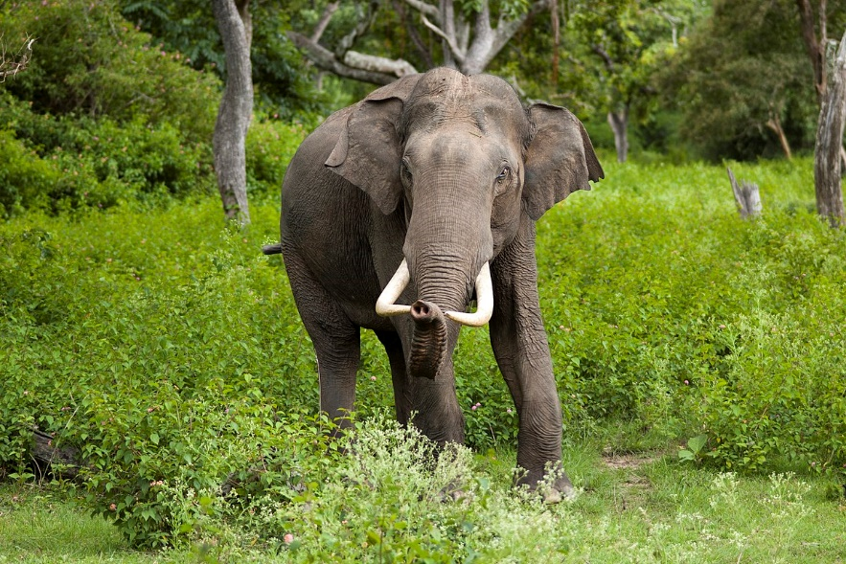
Living with elephants
Munene, the Chief and the Ranger
Munene walks along the edge of his family’s farm in the outskirts of the community. The elert-bracelet his father gave him lights up. He was told to keep a watch out for elephants if this bracelet lights up. Elephants have broken through neighbors' defenses before and eaten crops. Suddenly he sees grey figures, slowly moving along the tree line at the far end of the field. Elephants. Being alone, he decides to run to the village chief and tell him about the situation.
https://upload.wikimedia.org/wikipedia/commons/9/98/Elephas_maximus_%28Bandipur%29.jpg

Slide 4
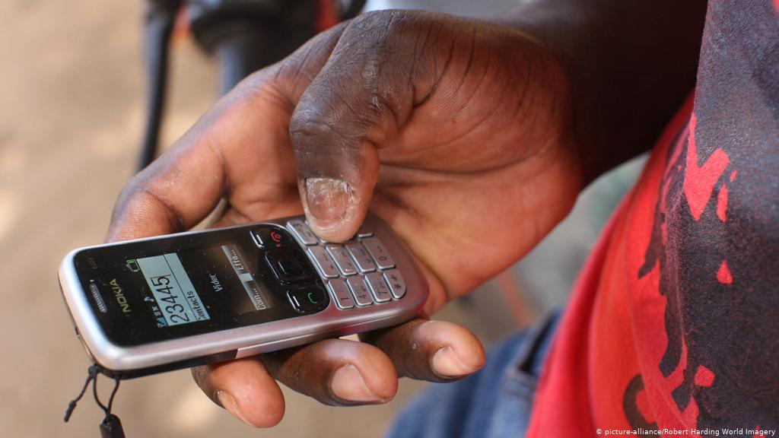
Living with elephants
Munene, the Chief and the Ranger
Munene rushes to the chieftain, but as he arrives, he sees him discussing with the other elders about an elephant in the area. The chieftain had received an automatic SMS-alert on his Nokia phone about elephants in the area. Now, with Munene’s help, they were able to determine their exact location and prepare themselves in time. They choose to notify Peace Park that the elephant has been found, in order to receive help from authorities.
https://m.dw.com/image/17645408_101.jpg

Slide 5
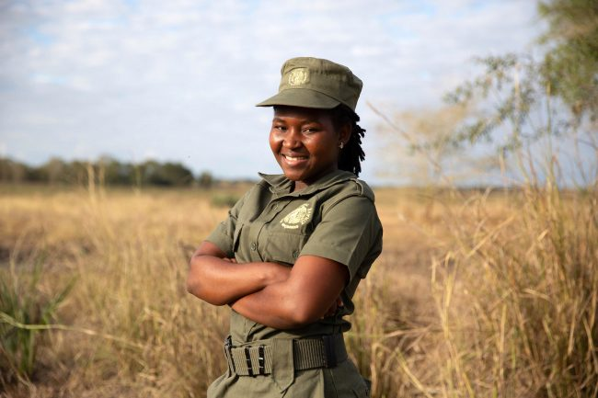
Living with elephants
Munene, the Chief and the Ranger
One of the rangers at Peace Parks receives the chieftain’s reply on her smartphone and checks the elert web-app for activity. She calls authorities with more resources, to head to the village and see the chieftain to safely resolve the conflict. The ranger can see on her device that this group of elephants have been in the area many times before. This means that they won’t spook easily and may have to be relocated to another part of the park. The authorities are notified of this and deploy proper countermeasures, tranquilizing the elephant.
https://worldelephantday.org/assets/MG_2019_Zinave_Med_03-650x433.jpg

Slide 6

The Elert-system
Early detection system
Enable locals to enact safe countermeasures by giving them time and awareness
Different levels of countermeasures can be taken at each level of organisation
Receive updates and forecasts on elephant positions
Chiefs
SMS-response alert
Locals
Communicate with authorities and locals
Organize local-response
Bracelet device
Peace Parks
Execute direct countermeasures

Slide 7
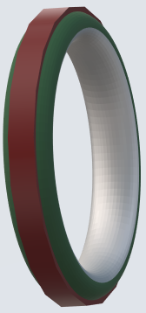
The Technology
Bracelet:
Rugged
Rigid
Has a warning light
GPS location data
LoRaWAN link to the Elert Backend
Provides current location to Elert backend, in order to determine risk status
Light ring lights up when risk is present
Low power, battery life exceeding 1 year
Mostly open-source, no liscence required

Slide 8
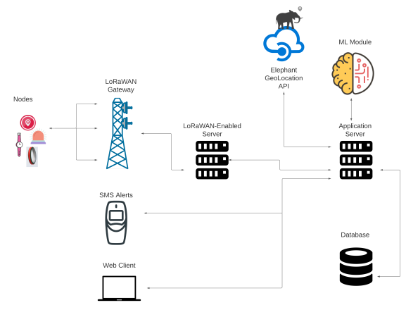
The Technology
Backend:
Receives elephant location details
Location data is stored in a database
Location data is processed using artificial intelligence, and deep learning to identify areas at risk
Responds to end-point regarding their location's risk
Send out automated SMS alert messages

Slide 9

The Technology
Web-app:
Uses device location data
Provides current location to Elert backend, in order to determine risk status
Push notification when risk is present
Learning platform, teaches correct procedure for handling incidents
Provides means to notify and request help from authorities
Auto-SMS:
Platform allows users to register their fixed location and mobile phone number
Done via the Elert Web and Mobile applications, sms or by 'snail' mail
Receive automated SMS alert whenever there is a risk of an HWC incident in their area.

Slide 10
Elert and AI
Data collected over time may be used for future implementations using ML-models
Gives park rangers the ability to forecast and predict elephant behavior using models
Enables Peace Parks workers to effectively communicate with and prepare local populations.
Open up potential for automatic countermeasures

Slide 11
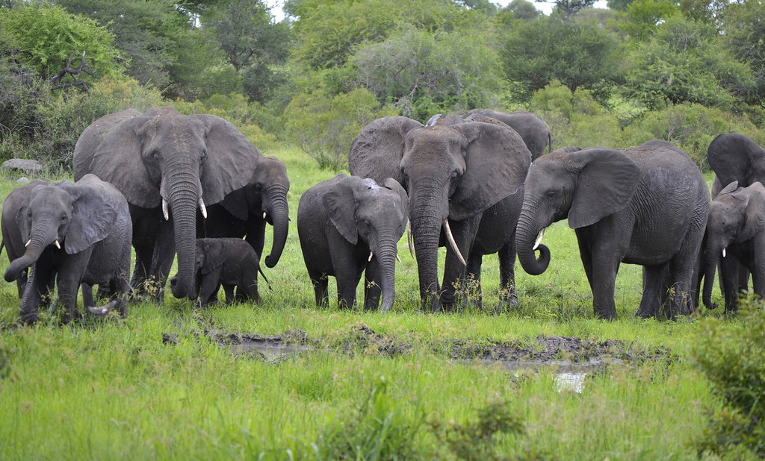
Future Applications
Data collected to find patterns:
Elephant positions (in relation to:)
Food sources
Settlements
Weather
Time
Seasons
Time to collect sufficient data
1m-36m
The DL-module can be fitted into the architecture of Elert, using data from the area in the server as input.
Data from other HWC-areas could also be used to create a generalized model.
https://live.staticflickr.com/5043/5342495338_fc63baee81_b.jpg

Slide 12
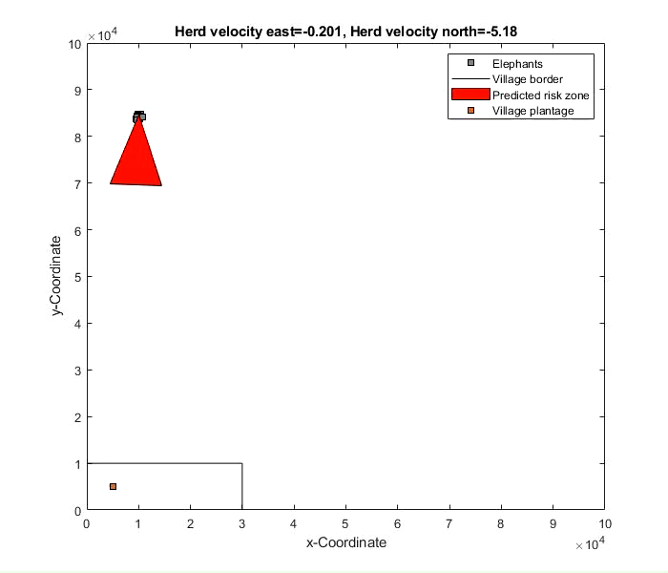
Future Applications
A model can be created to simulate the elephant’s behaviour, which can be used to forecast future movements.
Give the detection system a greater time-scope.
The DL-module can be fitted into the architecture of Elert, displaying data and the simulated model in the web-app UI

Slide 13
Future Applications
Timeline of future possibilities asmore data is collected
More complexity can be added to the model over time
Movements related to weather/season/migration ca. 36m
Flocking behaviors of herd individuals ca. 18m
Movements for foraging/food ca. 6m
Real-time predictions ca. 1m

Slide 14
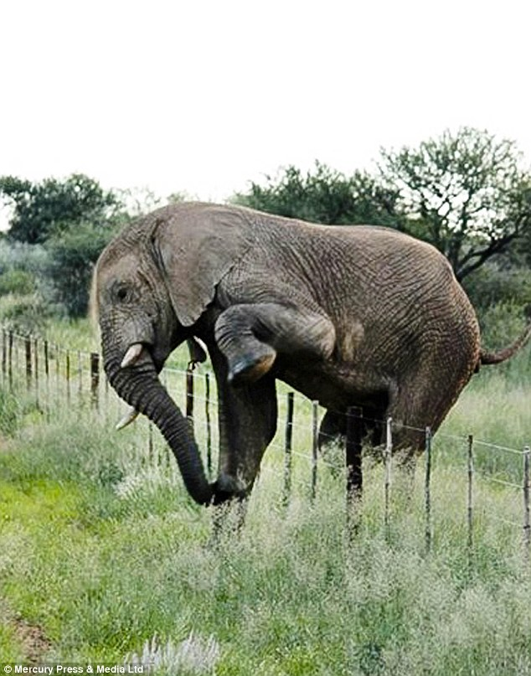
Future Applications
Automatic countermeasures::
Automatically notify public via public announcements
Luring defense
Ethical approach
Automatically lure away the elephants before they get to the village
Geofence
Automatically activated based on predictions
Automated alerting system
https://30pnmi117icg4bc3351vp2fe-wpengine.netdna-ssl.com/wp-content/uploads/2018/11/article-0-1C0E5F2500000578-864_634x807.jpg

Slide 15

Thank You!
Leith, Wenjin, Agaton, Kardo, Sebastian, Neville
If there are any question, don’t hesitate to ask us!
You can find our contact info on GitHub ☺
https://cnet3.cbsistatic.com/img/Yc72PRo6LDSAdwthGzUtQXF-Gjo=/2017/03/23/48e8c5e3-b87f-4549-bfbd-6db8140b5513/power-rangers-original.jpg

